Slide 1
COORDINATION LANGUAGES
A complete programming model can be built by combining two orthogonal models—a computation model and a coordination model.
The computation model provides the computational infrastructure and programmers can build computational activity using them
whereas the coordination model provides the support for binding all those computational activities together
A computational model supported by languages such as C, but by themselves cannot provide genuine coordination support among various computing activities.
A numerous distributed activities which have to be coordinated in a reliable and fault-tolerant manner by the coordination model.

Slide 2
COORDINATION LANGUAGES
Coordination can be seen through two different perspectives:
(1) based on centralized control, named as Orchestration and
(2)based on distributed transparent control, named as Choreography.
Choreography “it is the sequences and conditions in which multiple cooperating independent agents exchange messages in order to perform a task to achieve a goal state.”
Orchestration is “ it is the sequence and conditions in which one single agent invokes other agents in order to realize some useful function.”
There are many languages that provide Choreography and Orchestration support.
We briefly review some of the features in coordination languages such as Linda, eLinda, Orc, and Jolie.

Slide 3
Linda and eLinda
Linda is a coordination-programming model for writing parallel and distributed applications.
It takes the responsibility of enforcing communication and coordination, while general-purpose languages such as C, C++, and Java are used for computational requirements of the application.
The Linda model supports a shared-memory store called tuple space for communication between processes of the application.
Tuple spaces can be accessed by simple operations such as “out” and “in.”
These operations can be either blocking or non-blocking. (The out operation never blocks, and there can be any number of copies of the same tuple in tuple space.)
CppLINDA is a C++ implementation of the Linda coordination model.

Slide 4
Linda and eLinda
The eLinda model extends Linda.
It adds a new output operation “wr” that can be used with the “rd” input operation to support broadcast communication.
In Linda, if a minimum value of a dataset stored in a tuple space is required, all matching field values should be read, the reduction should be performed, and then the remaining data should be returned to the tuple space.
While this procedure is accessing the tuple space to extract the minimum value, the tuple space is not accessible to other processes, which restricts the degree of parallelism by a large amount.
eLinda proposes the “Programmable Matching Engine” (PME) to solve problems such as the previous one.
The PME allows the programmer to specify a custom matcher that can be used internally to retrieve tuples from the shared.

Slide 5
Orc
Orc is a coordination language for distributed and concurrent programming.
It is based on process calculus.
It provides uniform access to computational services, including distributed communication and data manipulation.
A brief overview of the language features is as follows:
The basic unit of computation in Orc is called a site, similar to a function or a procedure in other languages. The sites can be remote and unreliable.
Sites can be called in the form of C(p); C is a site name and p is the list of parameters. The execution of a site-call invokes the service associated with the site. The call publishes the response if the site responds.

Slide 6
Orc
Orc provides several fundamental sites, such as Rwait(t), Prompt(), and so forth, to promote writing efficient programs.
Orc allows users to define local functions. Function-calls act and look a lot like site-calls, with a few exceptions:
  A site call will block if some of its arguments are not available, but a function call does not.
  A site call can publish at most one value, but a function call can publish more than one value. Orc also supports functions and sites as arguments to a function call.
The recent Orc implementation is allowing Java classes to be used as sites

Slide 7
Jolie
Jolie (Java Orchestration Language Interpreter Engine) is an orchestration language for services in Java-based environments.
The statement composers and dynamic fault handling are two important features in this language.
fault handlers are basically statically programmed
But In dynamic fault handling, they are installed dynamically at the execution time.
In Jolie there are basically three statement composers: sequence, parallel, and input choice.

Slide 8


Jolie
Statements can be composed sequentially, using “;” operator.
It means that the statement to the left of the sequence operator is executed first, and then the statement to the right of it.
The syntax of the sequence statement is as follows.
statementx gets executed first and then the statementy.
The “|” operator is used to compose statements in parallel.
The statements to the left and right of the parallel operator are executed concurrently.

Slide 9

Jolie
The third composer is for guarded input.
Here, when a message for an input statement is received, all the other branches are deactivated and the corresponding branch is executed.
The syntax is as shown in the listing.
If the message is received on the input statement IS_2, then branch_code_1 and branch_code_3 are disabled, and execution continues through branch_code_2.
Since IoT is characterized by distributed execution, we believe explicit coordination-language support with minimal features for coordination and composition, for different work-flow patterns is a must for any IoT programming framework

Slide 10
POLYGLOT PROGRAMMING
Polyglot programming is also called multilingual programming. It is an art of developing simpler solutions by combining the best possible solutions using different programming languages and paradigms.
This is based on the observation that there is no single programming paradigm or a programming language which can suit all the facets of modern-day programming or software requirements.
It is also called poly-paradigm programming (PPP)
many modern-day software combines a subset of imperative, functional, logical, object-oriented, concurrent, parallel, and reactive programming paradigms

Slide 11
POLYGLOT PROGRAMMING
definition1: “programming in more than one language within the same context.”
definition2: “using multiple programming languages on the same managed run-time.”
The extended definition from developer’s, perspective as: “programming in more than one language within the same context, where the context is either within one team, or several teams where the integration between the resulting applications require knowledge of the languages involved.”

Slide 12
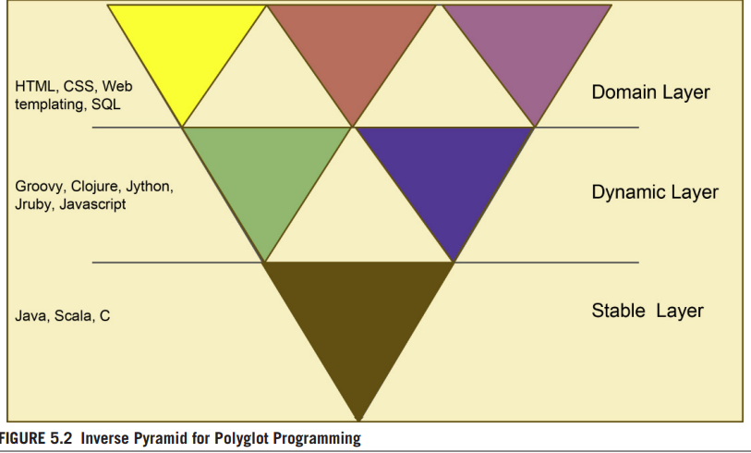
The inverse pyramid for Polyglot Programming

Slide 13
The inverse pyramid for Polyglot Programming
The Inverse pyramid has three layers: stable, dynamic, and domain, as shown in
Statically typed programming-languages such as Java and C that provide well-tested and stable functionality settle toward the stable layer.
The less powerful general-purpose technologies, such as HTML and CSS, which are tightly coupled to a specific part of the application, bubble up to the top layer.
The dynamic layer in the middle consists of a variety of programming languages such as Groovy and Clojure, which are more flexible and aid rapid functionality development.

